Slide 1
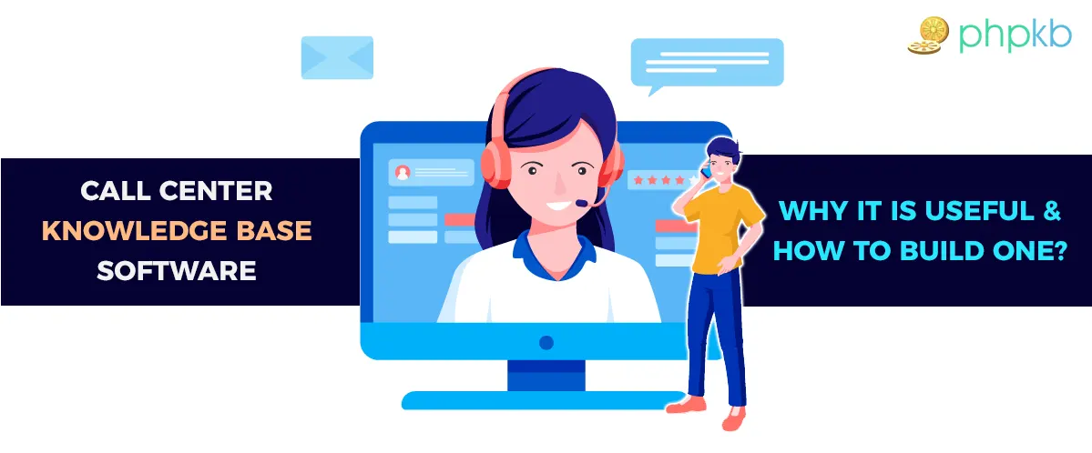
Why Call centers Need A Knowledge Base Software ??

Slide 2
What is a knowledgebase software ?
Centralized knowledge platform That contains your Products information (Guides , Manuals,Training Material...etc), where your employees can find anything they need.
It consists of detailed information regarding your company’s policies, work dynamics, projects, internal processes, and much more.

Slide 3

Why Would You Need an Internal Knowledge Base?
Reduce Error.
Enhance Employee Productivity.
Growth & Prevent Knowledge Loss.
Training and onboarding.
Improve Customer Service.

Slide 4


Reduce Errors
Digging into emails , old Word Pad and excel sheets it is really a Heavy Load on Service Agents.
Regardless the Health of the involved contents also the Agent Performance is effected as he cannot Answer The questions or Making The Right Request for Customer Effectively Correctly and quickly.
Unorganized Documents
Digging in old emails

Slide 5

Video from Big is nothing movie

Slide 6
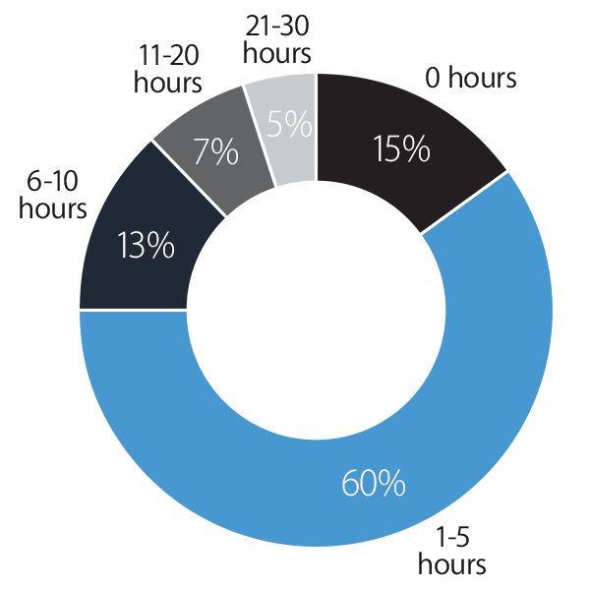
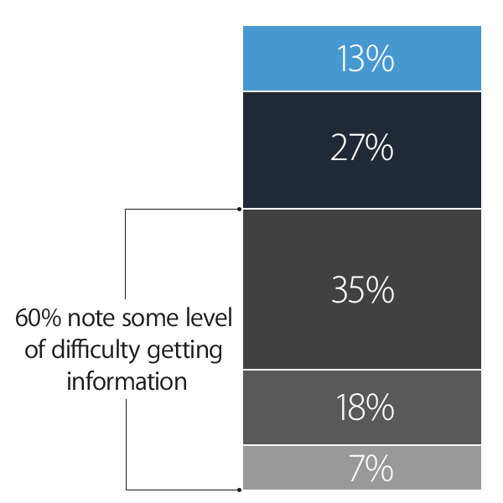
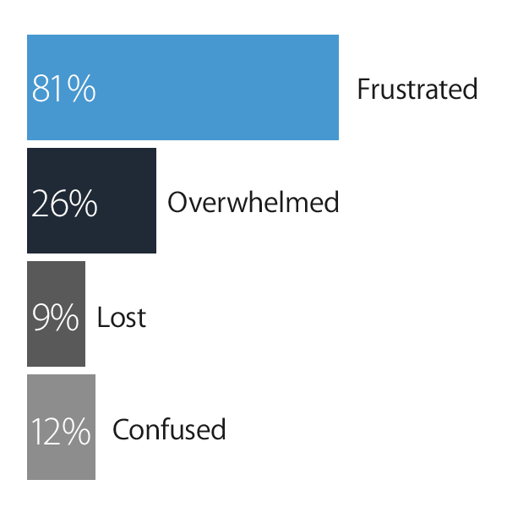
Surveyed 1001 US employees across a variety of industries
60% of employees report that it is difficult, very difficult, or nearly impossible to obtain information from their colleagues needed to do their job.
Employees spend 5.3 hours per week waiting for information. These delays have a major impact on project schedules — 66% will last up to a week, and 12% a month or more.
81% of employees are frustrated when they cannot access the information they need to properly do their job.
Source : https://www.panopto.com/resource/valuing-workplace-knowledge/

Slide 7



Enhance Employee Productivity
By using internal knowledge base software to gather common support documentation and FAQs, you can make it easier for your customer service team to provide prompt service as they won’t have to sift through tons of information to find the right answer.
Immediate Response for Supporting as mitigating A Customer Frustration in the High Volume Queue times, While Customer Waiting Too Much Time.
Gain Experiences More Quickly And Confidence.

Slide 8
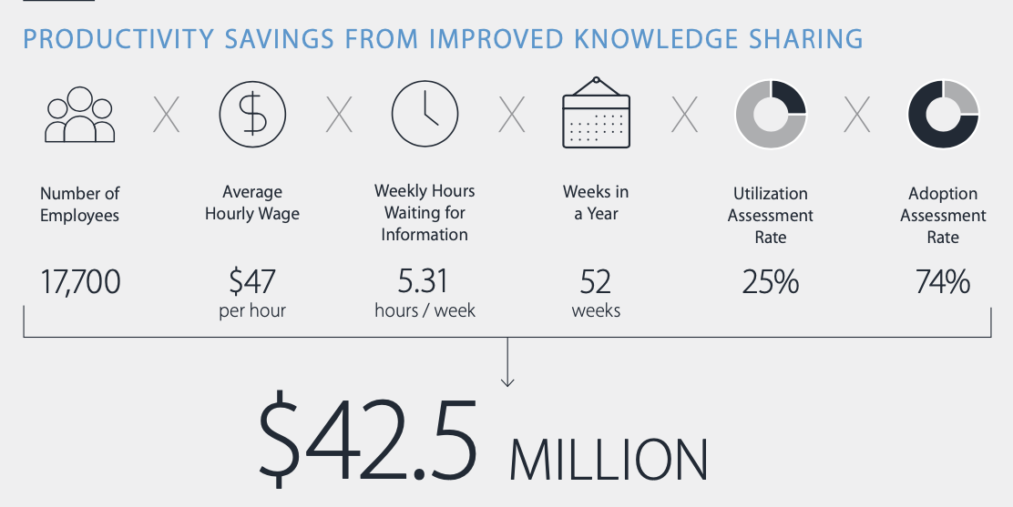
Growth & Prevent Knowledge Loss
organization is at risk every time an employee leaves the company, as you have to spend time, energy, and resources to regain the lost know-how.
The average U.S. enterprise-sized company loses an estimated $42.5M per year due to insufficient knowledge sharing, with knowledge loss playing a big part

Slide 9

Video of the knowledge retention

Slide 10
Training and onboarding
With new call center executives being hired, it is hard to train each individual, and training can take up a lot of productive time.
A knowledge base can serve it all, you can use it as a learning management system to train and onboard new support agents.
The call center knowledge base can have all the data such as business processes, manuals that newcomers can go through before actually being in operation.

Slide 11

Improve Customer Service
Customer Satisfaction
FCR
Reduced AHT
Employee retention and satisfaction

Slide 12
Thank YOU

